Slide 1
Genre Overload
Moving towards a Knowledge Based Writing Curriculum
@teach_well
http://www.teach-well.com

Slide 2
Background: Knowledge Base
Cognitive Load Theory (Sweller, Ashman)
Knowledge Based Curriculum (Hirsch)
Curriculum as Model (Fordham)
Assessment (Christodoulou)

Slide 3
“I just changed one thing and it’s like they’ve never learnt any of it before!!”

Slide 4
Cognitive Load

Slide 5
Cognitive Load
storing/conscious processing
limited in duration (stored for 30 secs if not rehearsed)
in capacity (between 3 and 7 items for storing, less depending on the nature of processing.)
limitations apply to new, yet to be learned information that has not been stored in the long term memory.

Slide 6
Cognitive Load
No limits
Overrides the limitations of working memory.
Source: Why Minimal Guidance During Instruction Does Not Work: An Analysis of the Failure of Constructivist, Discovery, Problem-Based, Experiential, and Inquiry-Based Teaching; Kirschner, Sweller and Clark (2006).

Slide 7
Cognitive Load
Source: Why Minimal Guidance During Instruction Does Not Work: An Analysis of the Failure of Constructivist, Discovery, Problem-Based, Experiential, and Inquiry-Based Teaching; Kirschner, Sweller and Clark (2006).

Slide 8
Schemas
system of organising information in long term memory
reduces load on working memory
Allows more complex tasks like evaluation and analysis
Source: David Didau and Nick Rose: What Every Teacher Needs to Know about Psychology
Notes:
1) Inherent difficulty of the subject matter being learnt (Sweller 1994, 2010; Sweller & Chandler 1994)
Simple to complex
Part-whole
Full complexity but draw attention to individual elements
2) A combination of high intrinsic and high extraneous cognitive load may be fatal to learning because working memory may be substantially exceeded … [I]t may be essential to design instruction in a manner that reduces extraneous cognitive load.(Sweller, van Merrienboer & Paas 1998, pp. 263-264)
3) load imposed on the working memory by the process of learning – that is, the process of transferring information into the long-term memory through schema construction (Sweller, van Merrienboer & Paas 1998, p. 259).

Slide 9
National Curriculum 2014
Changes?

Slide 10
Writing Curriculum: Old and New
Text Type | Number of “Genres”
Narrative | 20
Non-fiction | 15
Poetry | 16
Additional text-based units | 8
Text Type | Number of “Genres”
Narrative | 10
Non-fiction | 6
Poetry | 3

Slide 11
National Curriculum 2014 - Writing
 | Year 1 | Year 2 | Year 3 | Year 4 | Year 5 | Year 6
Narrative | sequencing sentences to form short narratives | writing narratives about personal experiences and those of others (real and fictional) | creating settings, characters and plot |  | Considering how authors have developed characters and settings in what pupils have read, listened to or seen performed Describing settings, characters and atmosphere and integrating dialogue to convey character and advance the action
Non-Fiction |  | writing about real events | Using simple organisational devices [for example, headings and sub- headings] |  | Using further organisational and presentational devices to structure text and to guide the reader [for example, headings, bullet points, underlining]
Poetry |  | writing poetry
General |  | writing for different purposes | write for a range of real purposes and audiences , such as a narrative, an explanation or a description.

Slide 12
Genre Overload

Slide 13
Case Study – Leicester City

Slide 14
NLS Problems Left Unresolved by NC 2014

Slide 15
Years 1 - 6 Narrative
Y1 | Stories with familiar settings | Traditional and fairy tales (includes plays) | Stories from a range of cultures* | Stories about fantasy worlds |  |  |  |  | Stories with predictable and patterned language*
Y2 | Stories with familiar settings | Traditional stories |  |  |  | Significant authors* Different stories by the same author | Extended stories*
Y3 | Stories with familiar settings | Myths and legends |  | Adventure and mystery |  | Authors and letters |  | Dialogue and plays
Y4 | Stories which raise issues/ dilemmas |  | Stories from other cultures | Stories set in imaginary worlds | Stories with historical settings |  |  | Plays
Y5 |  | Traditional stories, fables, myths, legends | Stories from other cultures |  |  | Novels and stories by significant children's authors | Film narrative | Dramatic conventions | Older literature
Y6 |  |  |  |  |  | Authors and texts | Extending narrative Short stories with flashbacks |  | Fiction genres

Slide 16
Years 1 - 6 Non-Fiction
Y1 | Labels, lists and captions |  | Information texts | Instructions | Recounts, dictionary Recounts (Fact and Fiction)
Y2 |  | Non-chronological reports | Information texts | Instructions |  |  | Explanations
Y3 |  | Reports | Information texts | Instructions
Y4 |  |  | Information texts |  | Recounts: newspapers/ magazines | Persuasive texts | Explanation texts
Y5 |  |  |  | Instructions | Recounts | Persuasive writing Persuasion (Transition Unit)
Y6 |  |  |  |  | Journalistic writing | Persuasion |  | Argument Biography and autobiography Formal/impersonal writing

Slide 17
Engagement
Source: Professor Robert Coe
Notes:
Does not mean it’s undesirable or conflicts with learning.

Slide 18
Enjoyment
Correlation between writing frequency, attainment and enjoyment.
Source: National Literacy Trust: Children and Young People’s Writing (2015), Writing for Enjoyment (?)

Slide 19
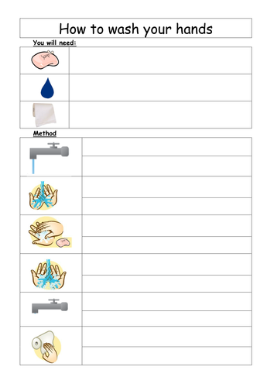
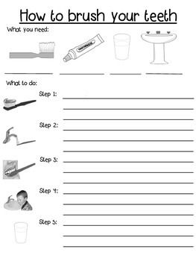
Models/Scaffolds

Slide 20
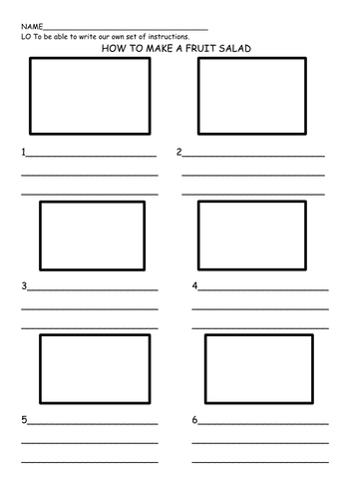
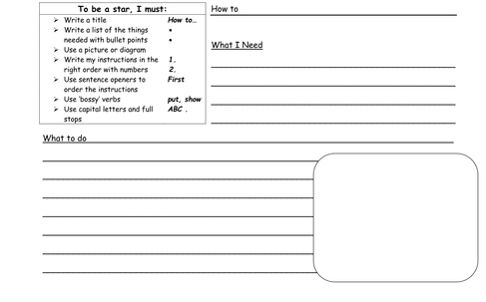
Models/Scaffolds

Slide 21
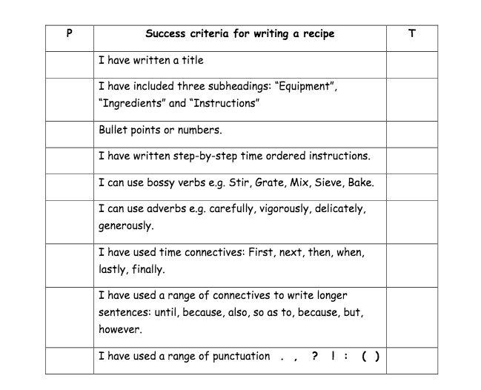
Success Criteria

Slide 22
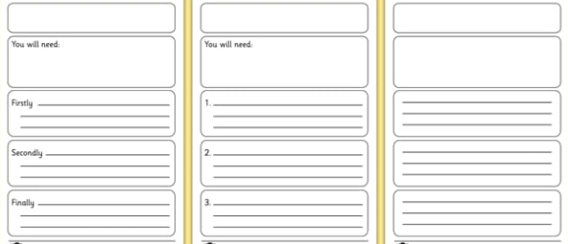
Differentiation

Slide 23
Towards a Knowledge-Based Writing Curriculum
Actual prior learning
Consistent scaffolds across year groups, gradually withdrawn
Writing Across the Curriculum – subject based not generic non-fiction.

Slide 24
Towards a Knowledge-Based Writing Curriculum Fewer genres/shorter units of writing

Slide 25
 | Aut1 | Aut2 | Spr1 | Spr2 | Sum1 | Sum2
Y5 | Character Description Narrative - Retell Explanation | Setting Description Explanation Essay | Character Description Narrative - Retell Explanation | Setting Description Explanation Essay | Character Description Narrative - Retell Biography | Setting Description Essay Biography
Y6 | Character Description Narrative - Retell Explanation | Setting Description Essay Biography Diary Entry | Character Description Narrative - Retell Explanation | Setting Description Essay Biography Diary Entry | Character Description Narrative - Retell Explanation | Setting Description Essay Biography Diary Entry

Slide 26
Towards a Knowledge-Based Writing Curriculum

