Slide 1
THE HOLY Grail OF teaching SPELLING
Tarjinder Gill
@teach_well
http://www.teach-well.com/

Slide 2
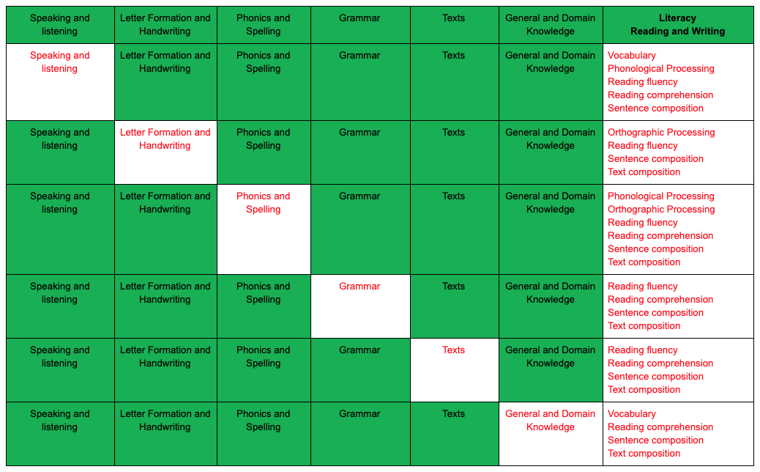

Slide 3
The holy grail of teaching spelling
1. Barriers to Extended Writing
2. Spelling: What Knowledge?
3. Common Teacher Misconceptions
4. Teaching Spelling
5. The Holy Grail?

Slide 4
THE Holy GRAIL OF teaching spelling
Barriers to Extended Writing

Slide 5
Barriers to extended writing
Handwriting
Spelling
Sentence Construction

Slide 6
THE Holy GRAIL OF teaching spelling
Spelling: What Knowledge?

Slide 7
Spelling: What Knowledge?
English
Literature
Language
Reading
Writing
Word Reading
Comprehension
Transcription
Composition
Spelling
Handwriting
Grammar
Text

Slide 8
Background
Spelling: What Knowledge?
Writing
Transcription
Morphology
Spelling patterns/GPCs
1:1
Digraphs
Trigraphs
Multigraphs
Spelling
Prefixes
Suffixes
Homophones and Near Homophones
Common Exception Words/Statutory Spellings
Words
Etymology

Slide 9
Spelling: What Knowledge?
Phonemic Awareness
Alphabet
Letter Formation
1:1 GPCs
Syllables
GPCs -digraphs/ trigraphs/multigraphs
GPCs – unusual/rare
Decoding/Encoding
Morphology and Etymology

Slide 10
THE Holy GRAIL OF teaching spelling
Common Teacher Misconceptions

Slide 11
Some words can’t be sounded out
Spelling can't be taught
Impact of correction
Interchanging 1:1 GPC for letters and sounds
Common Teacher Misconceptions

Slide 12
Common Teacher Misconceptions
Spelling can't be taught
Spelling rules
Spelling patterns
GPCs

Slide 13
Common Teacher Misconceptions
Year Group | 1:1 | Regular spelling patterns/GPCs | Irregular spelling patterns/ rare or unusual GPCs
Reception | Yes | Yes | No
Year 1 | No | Yes | Common exception words
Year 2
Years 3 - 6 |  | No | NC Objectives Statutory spellings

Slide 14
Common Teacher Misconceptions
Spelling can't be taught
Spelling rules: Morphology
plurals – s or es
changing verb tenses – ed/ing
comparative/superlatives – er/est

Slide 15
Common Teacher Misconceptions
Year Group | GPC’s | Morphology
Reception | Depends on Phonics Scheme | No
Year 1 | The sounds /f/, /l/, /s/, /z/ and /k/ spelt ff, ll, ss, zz and ck The /ŋ/ sound spelt n before k -tch The /v/ sound at the end of words Words ending –y Using k for the /k/ sound ai, oi, ay, oy, a-e, e-e, i-e, o-e, u-e, ar, ee, ea (/i:/), ea (/ɛ/) , er (/ɜ:/), er (/ə/), ir, ur, oo (/u:/), oo (/ʊ/), oa, oe, ou, ow (/aʊ/), ow (/əʊ/), ue, ew, ie (/aɪ/), ie (/i:/), igh, or, ore, aw, au, air, ear, ear (/ɛə/), are (/ɛə/), ph, wh | The prefix un using the spelling rule for adding –s or –es as the plural marker for nouns and the third person singular marker for verbs using –ing, –ed, –er and –est where no change is needed in the spelling of root words [for example, helping, helped, helper, eating, quicker, quickest]

Slide 16
Common Teacher Misconceptions
Year Group | GPC’s | Morphology
Year 2 | kn, gn The /dʒ/ sound spelt as ge and dge at the end of words, and sometimes spelt as g elsewhere in words before e, i and y The /s/ sound spelt c before e, i and y The /r/ sound spelt wr at the beginning of words The /l/ or /əl/ sound spelt –le at the end of words The /l/ or /əl/ sound spelt –el at the end of words The /l/ or /əl/ sound spelt –al at the end of words Words ending –il The /ɔ:/ sound spelt a before l and ll The /ʌ/ sound spelt o The /i:/ sound spelt –ey The /ɒ/ sound spelt a after w and qu The /ɜ:/ sound spelt or after w The /ɔ:/ sound spelt ar after w The /ʒ/ sound spelt s The /aɪ/ sound spelt –y at the end of words | Adding –es to nouns and verbs ending in –y Adding –ed, –ing, –er and –est to a root word ending in –y with a consonant before it Adding the endings –ing, –ed, –er, –est and –y to words ending in –e with a consonant before it Adding –ing, –ed, –er, –est and –y to words of one syllable ending in a single consonant letter after a single vowel letter add suffixes to spell longer words, including–ment, –ness, –ful , –less, –ly Words ending in –tion

Slide 17
Common Teacher Misconceptions
Year Group | GPC’s | Morphology
Years 3 & 4 | Words with the /s/ sound spelt sc (Latin in origin) The /ʌ/ sound spelt ou Words with endings sounding like /ʒə/ or /tʃə/ Words with the /ʃ/ sound spelt ch (mostly French in origin) Words ending with the /g/ sound spelt – gue and the /k/ sound spelt –que (French in origin) Words with the /eɪ/ sound spelt ei, eigh, or ey The /ɪ/ sound spelt y elsewhere than at the end of words Words with the /k/ sound spelt ch (Greek in origin) | Adding suffixes beginning with vowel letters to words of more than one syllable The suffix –ly More prefixes: un, dis, mis, il, im, in, ir, re, sub, inter, super, anti, auto The suffix –ation Endings which sound like /ʃən/, spelt –tion, –sion, –ssion, –cian The suffix –ous, our

Slide 18
Common Teacher Misconceptions
Year Group | GPC’s | Morphology
Years 5 & 6 | Words containing the letter-string ough spell some words with ‘silent’ letters [for example, knight, psalm, solemn] | Endings which sound like /ʃəs/ spelt –cious or –tious (actual suffix is ious) Words ending in –ant, –ance/–ancy, –ent, –ence/–ency Words ending in –able and –ible Words ending in –ably and –ibly Adding suffixes beginning with vowel letters to words ending in –fer Endings which sound like /ʃəl/

Slide 19
Common Teacher Misconceptions
Some words can’t be sounded out
Words that can be read and said but not broken down into GPCs.
a
I
These two words can’t be broken into sounds as only one sound.

Slide 20
Common Teacher Misconceptions
Some words can’t be sounded out
High frequency/tricky words
the
is
go/no/so
said

Slide 21
Common Teacher Misconceptions
Some words can’t be sounded out
sed
iz
luv
s ai d
i s
l o ve

Slide 22
Common Teacher Misconceptions
Interchanging 1:1 GPC for letters and sounds
s ai d

Slide 23
Common Teacher Misconceptions
Impact of Correction
Self esteem
Phonetically plausible
Writing – accuracy vs stamina

Slide 24
THE Holy GRAIL OF teaching spelling
Teaching Spelling

Slide 25
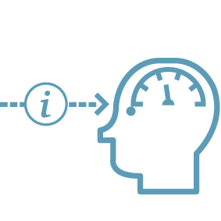
Teaching Spelling
Schema - (Anderson - https://files.eric.ed.gov/fulltext/ED239236.pdf)
Explicit instruction - (Kirschner, Sweller and Clark -https://www.tandfonline.com/doi/abs/10.1207/s15326985ep4102_1)
Impact of rote learning - (Quigley - https://www.theconfidentteacher.com/2018/05/spelling-avoiding-ignorance-and-negligence/)

Slide 26
Teaching Spelling
Year Group | GPCs | Morphology | Common Exception Words/Statutory Spellings | Homophones and Near Homophones
Reception | Yes | No | Yes | No
Year 1 | Yes | Yes | Yes | No
Years 2 - 6 | Yes | Yes | Yes | Yes

Slide 27
Teaching Spelling
Daily Teaching – Year 1
Monday | Tuesday | Wednesday | Thursday | Friday
GPC | Common Exception Words | Recap GPC and Common Exception Words | Dictated sentences | Test

Slide 28
Teaching Spelling
Daily Teaching – Years 2 -6
 | Monday | Tuesday | Wednesday | Thursday | Friday
GPC | GPC | Common Exception Words/Statutory Spellings | Homophones/Near Homophones | Dictated sentences | Test
Morphology | Prefix or Suffix | Common Exception Words/Statutory Spellings | Prefix or Suffix | Dictated sentences | Test

Slide 29
Teaching Spelling
Daily Teaching – Years 2 -6
 | Monday | Tuesday | Wednesday | Thursday | Friday
GPC | GPC | Common Exception Words/Statutory Spellings | GPC | Dictated sentences | Test
Morphology | Prefix or Suffix | Common Exception Words/Statutory Spellings | Prefix or Suffix | Dictated sentences | Test
Homophones/Near Homophones | Homophones/ Near Homophones | Common Exception Words/Statutory Spellings | Homophones/Near Homophones | Dictated sentences | Test

Slide 30
Teaching Spelling
explicit instruction
meaning
quick quizzing
use of mini-whiteboards
scaffolds
linking to prior knowledge
repeated practice
feedback and correction

Slide 31
Teaching Spelling
GPC
Teaching Sequence | Pronunciation | Word (repeat 3 to 4 times) | Practice
 | my turn/ your turn link to prior knowledge explanation | my turn/your turn meaning – define/picture/gesture monosyllabic - break down word into GPCs polysyllabic – break into syllables and then into GPCs | say words children write words
Example: | que c, k, ck French origin | plaque - p l a que picturesque – pic/ture/resque p i c/t ure/r e s que | que _ _ _/t _/_ _ _ _

Slide 32
Teaching Spelling
Common Exception Words/Statutory Spellings
Teaching Sequence | Pronunciation and Word (repeat 3 to 4 times) | Practice
 | my turn/your turn meaning – define/picture/gesture monosyllabic - break down word into GPCs polysyllabic – break into syllables and then into GPCs | say words children write words
Example: | eight – eigh t century – cen/tu/ry c e n/t u/r y | eigh _ _ _ _/t _ /_ _

Slide 33
Teaching Spelling
Homophones and near homophones
Teaching Sequence | Pronunciation | Meaning | Usage
 | my turn/ your turn | definition/picture/gesture break down word into GPCs discussion or quick quiz | use in context – whiteboard work.
Example: | bear bare | bear – b ear bare – b are | The ____ lives in the woods. The cupboards are _____. ___ are animals.

Slide 34
Teaching Spelling
Morphology – prefix – Day 1
Teaching Sequence | Pronunciation | Word (repeat 3 to 4 times)
 | my turn/ your turn meaning | my turn/your turn meaning of root word – define/picture/gesture examples and non-examples
Example: Construct a Freya Diagram | re Latin origin -back/again | Examples: Non-examples: reappear real recycle ream

Slide 35
Teaching Spelling
Morphology – prefix – Day 2
Teaching Sequence | Pronunciation | Example words only (repeat 3 to 4 times) | Practice
 | Recap Quiz meaning | My turn/your turn Quick quiz for meaning Monosyllabic - break down word into GPCs Polysyllabic – break into syllables and then into GPCs | Say words Children write words
Example: | re | reappear – re/a/ppear r e/a/pp ear return – re/cy/cle r e/c y/c le | _ _/_ /pp __

Slide 36
Teaching Spelling
Morphology - suffix
Teaching Sequence | Pronunciation | Word Lists |  | Word (repeat 3 to 4 times)
 | My Turn/ Your Turn Meaning | root word and suffix meaning – define/picture/gesture |  | My turn/your turn Monosyllabic - break down word into GPCs Polysyllabic – break into syllables and then into GPCs
Example: | cian Latin origin - changing root word to a personal noun which denotes occupation (link to ‘er’ suffix) | Monday: magician logician electrician | Wednesday: mortician dietician beautician | magician - ma/gi/cian m a/g i/c ia n

Slide 37
THE Holy GRAIL OF teaching spelling
The Holy Grail?

Slide 38
The Holy Grail?
Step 1
Ensure NC coverage
Step 2
Step 3
Every year group reteaches GPCs of previous year groups
Phonic knowledge
Teach daily
Interleave GPC/morphology weeks
Block GPC’s and morphology
GPC checks each year
Word lists contain curriculum words
Tests include words from previous weeks/months/years in a systematic way
Revise list of GPCs taught
Test weekly

